Slide 1
Growth & Learning
4/17/2024

Slide 2
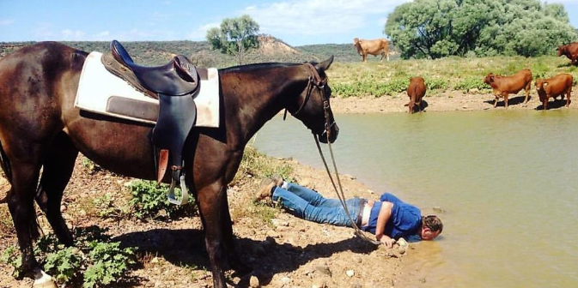
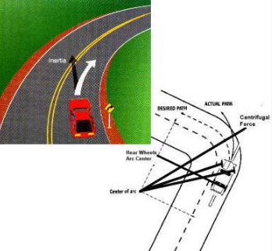
Our Working Habits – driven by our Principles
Culture eats Strategy for breakfast
Principles matter
drive outcomes

Slide 3
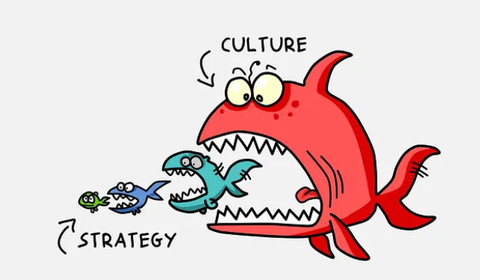
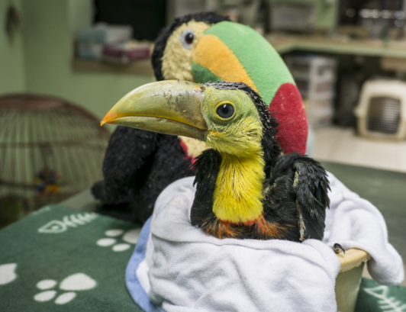
Goals of this talk
Increase the perceived value of “day to day” operational “how we work” choices
Encourage us to be active collaborators and LEADERS (but not dictators) in the development of “our” culture

Slide 4


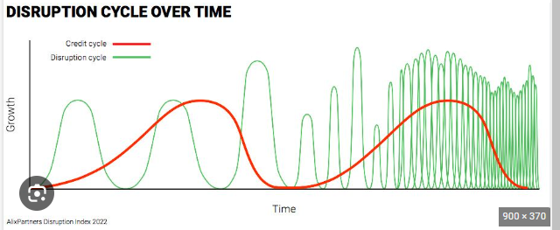
Assumptions
Culture trumps
We’re here anyhow
Complexity/disruption is increasing
We want to Win

Slide 5

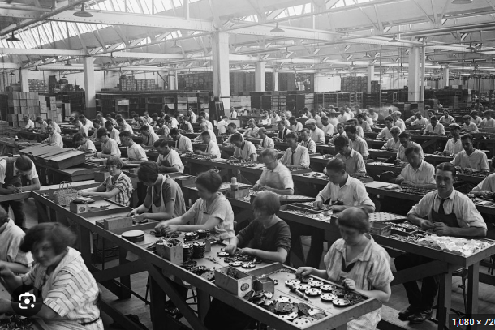
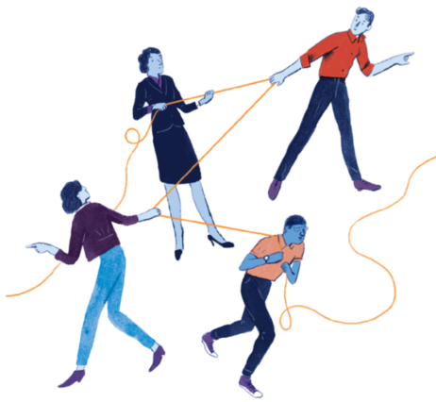
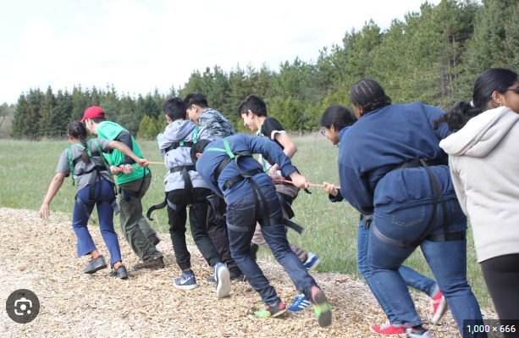
What do you prefer?
Taylorism
Individual teams Tribalism zero sum?
Individualism?
Team of teams – mindset of abundance

Slide 6
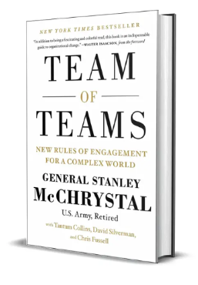
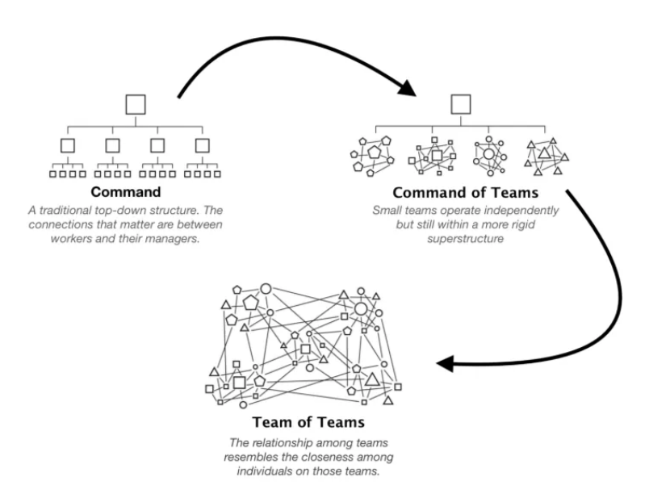

Authority as a Limiting Factor
The Perry Principle – tendency to control what is visible
Move to eyes on, hands off
The System is the strategy, like monopoly – game is different but the outcome is the same
Joint Cognition - Improved Resiliency and Speed

Slide 7

What Principles might we address in our culture?
Improvement
Focus on PROBLEMS (clarity) common purpose
Resiliency over Productivity over Efficiency
Transparency by Default (Coordination)
Curiosity – Build Competence
Work by Intent – bias toward action
Use Good Judgement Balance (good enough)

Slide 8
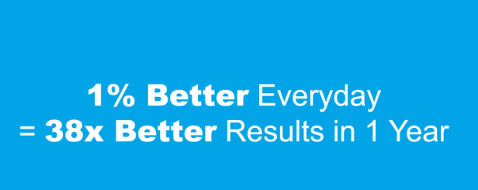
Improvement

Slide 9
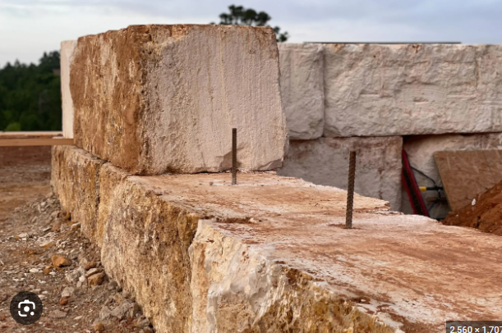
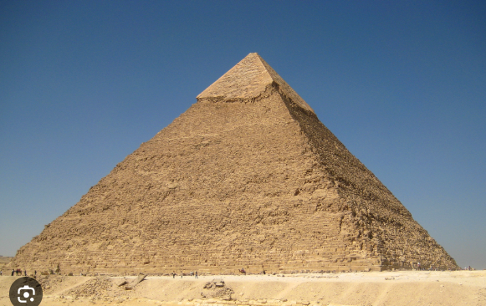

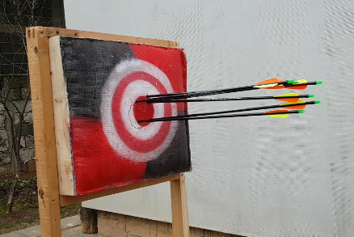
Focus - outcomes over outputs

Slide 10
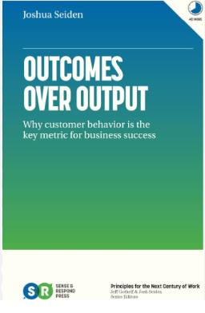
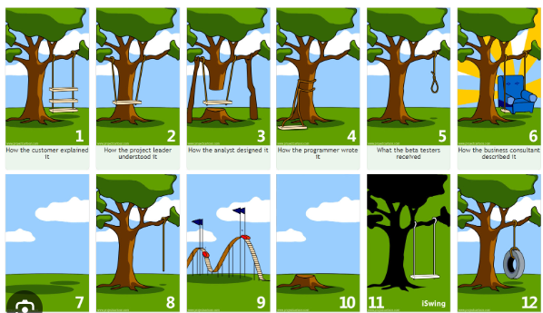
PROBLEMS (Clarity)
behaviors
Acceptable outcome: I want my 6 year old be able to swing under the tree safely
Provides structure to what we’re NOT doing
We must be on the same page

Slide 11

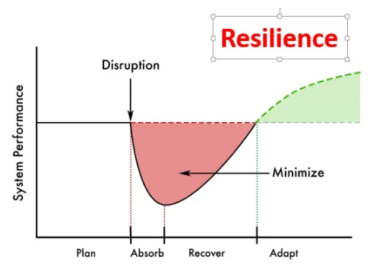
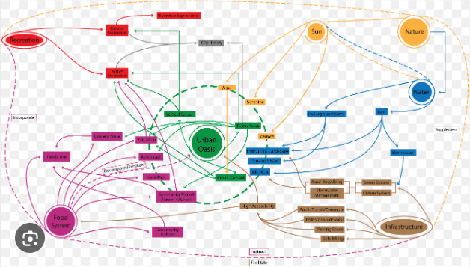
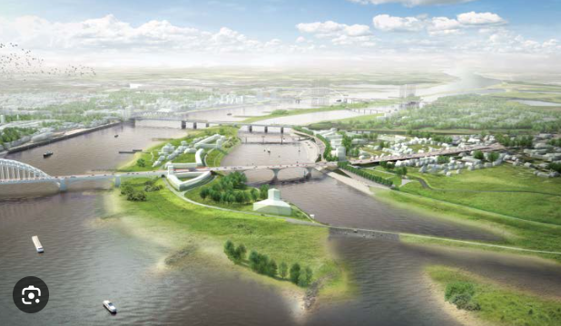

Resiliency over productivity
Predictable productivity is not possible without resiliency

Slide 12
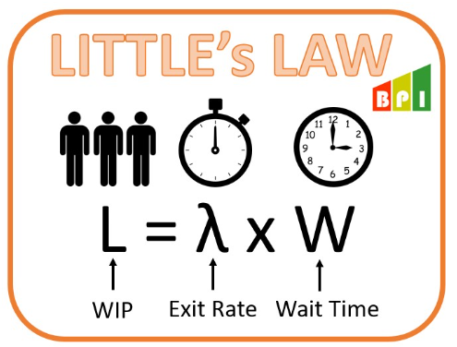
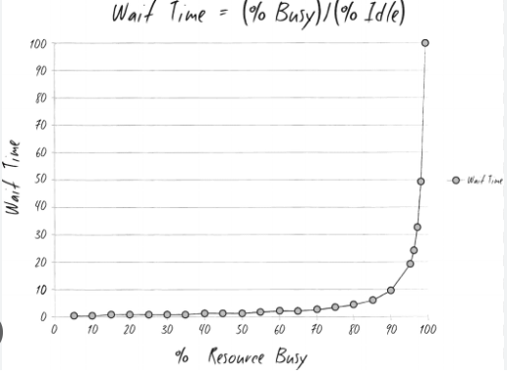

Productivity over Local efficiency
Expediting shortens wait time for urgent items, but increase context switching, reducing productivity/net value
Cycle time and wait time
How do we push down wait times? Become cross-functional/end to end (in teams, not possible for individuals)

Slide 13
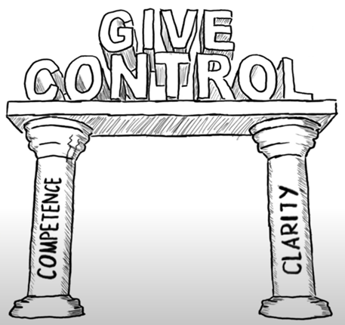
Transparency builds Shared Consciousness
https://www.youtube.com/watch?v=pYKH2uSax8U&list=PLg_BQpoFW2k341hHkO4_PhSnpJsOEaneY
Develop and Share
Question and Change
Embrace and Carry
FOCUS Understanding is required for resiliency

Slide 14



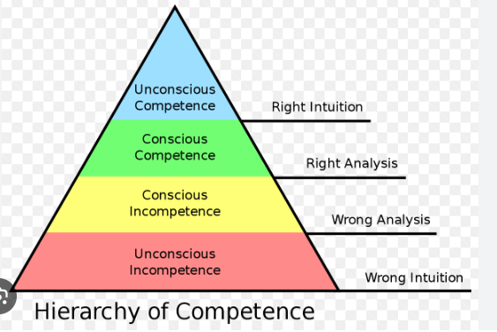
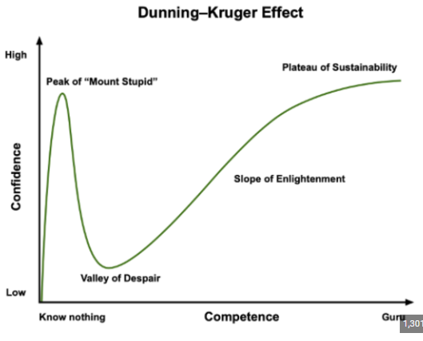
Curiosity
Builds Clarity and Competence
Demand Clarity (tactfully)

Slide 15
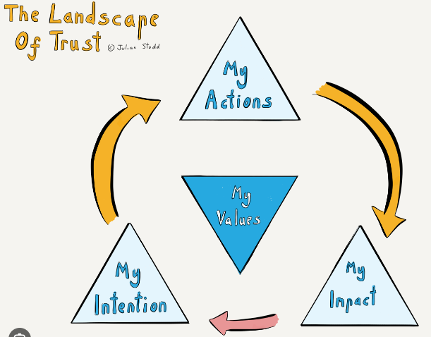

Intent – bias toward action (with transparency)
Don’t wait for permission if you’re at 70% today
But do communicate

Slide 16



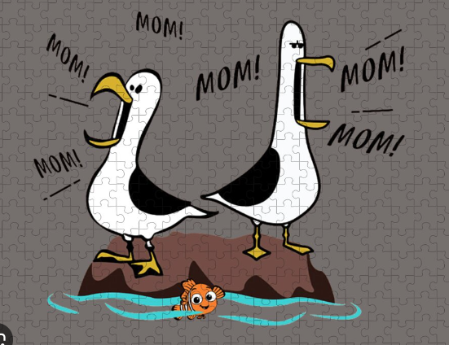
Balance in all things (Good judgement)
Analysis paralysis versus shooting from the hip
Acceptable cadence of inspection (retros)

Slide 17
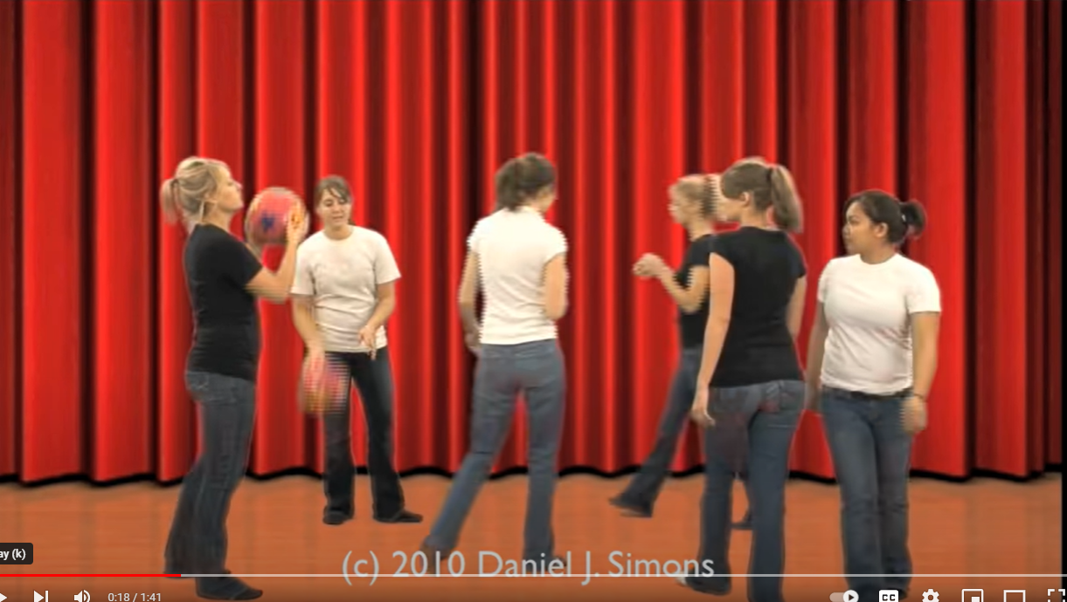
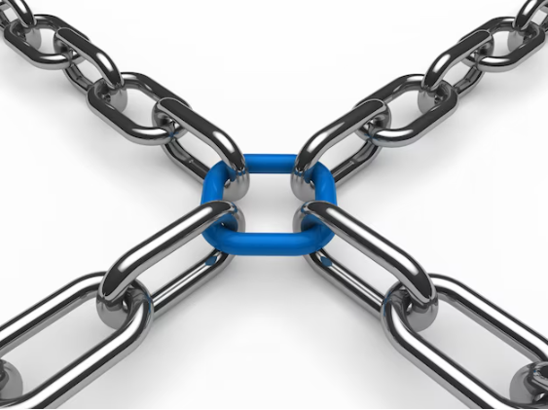
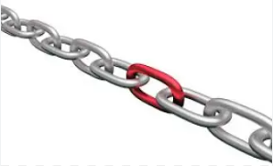
Even in focus (gorilla)
https://www.youtube.com/watch?v=IGQmdoK_ZfY
We do and should focus our own tasks. We need to open to others’ thoughts and experiences and open to them asking questions to better understand a larger portion of what’s going on

Slide 18
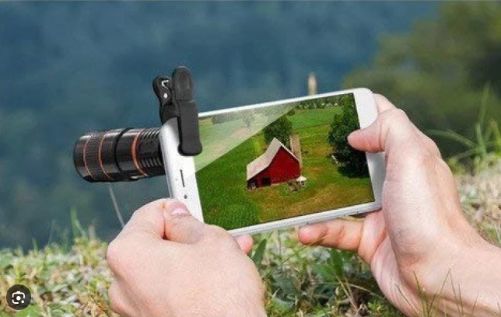

And Clarity

Slide 19
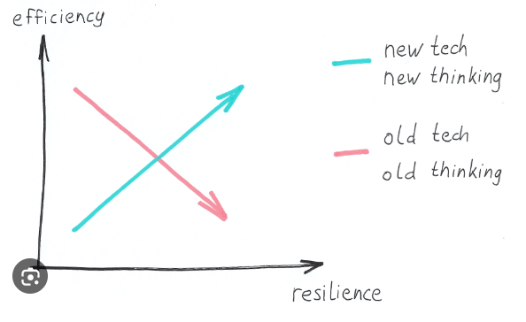
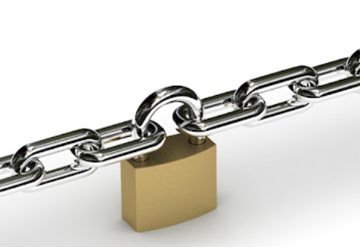
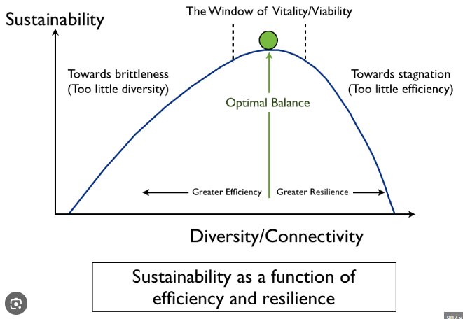
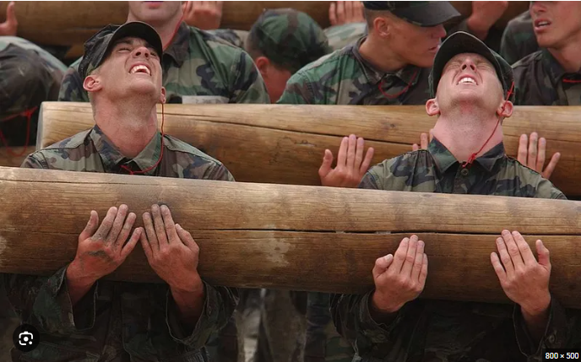
And Resiliency & Efficiency -- Good Enough
70% today over 90% tomorrow
local versus system optimization -Optimization at one node may reduce overall system operation

Slide 20


There are NO superheros
We must model the behavior and values that are the cogs in the system that bring the wins we desire
Value Delivery
Growth/Learning Mindset
Psychological Safety
Work/Life Balance

Slide 21
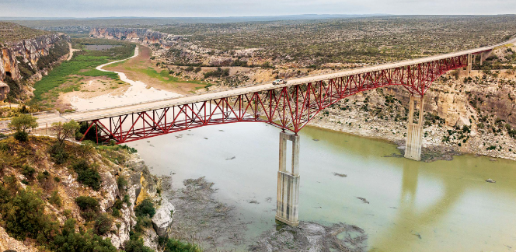
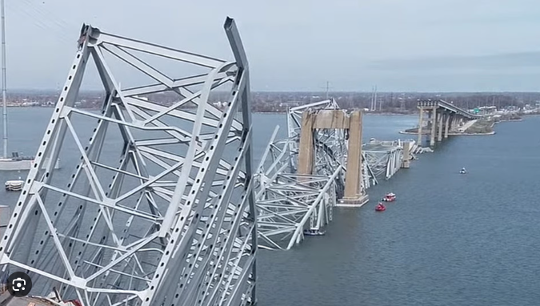
Truss – we all must bare our weight

Slide 22

Winning Principles Lead to Winning Behaviors which lead to Winning Outcomes

Slide 23
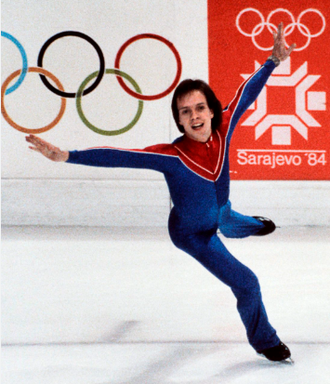
Asks of YOU:
Find your motivation! To win, we need to become active stewards of our culture.
You need to LEAD (collaborate but not dictator) in the areas where you are interested/skilled.

Slide 24



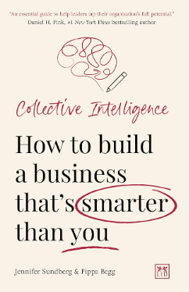



Bibliography

